Slide 1
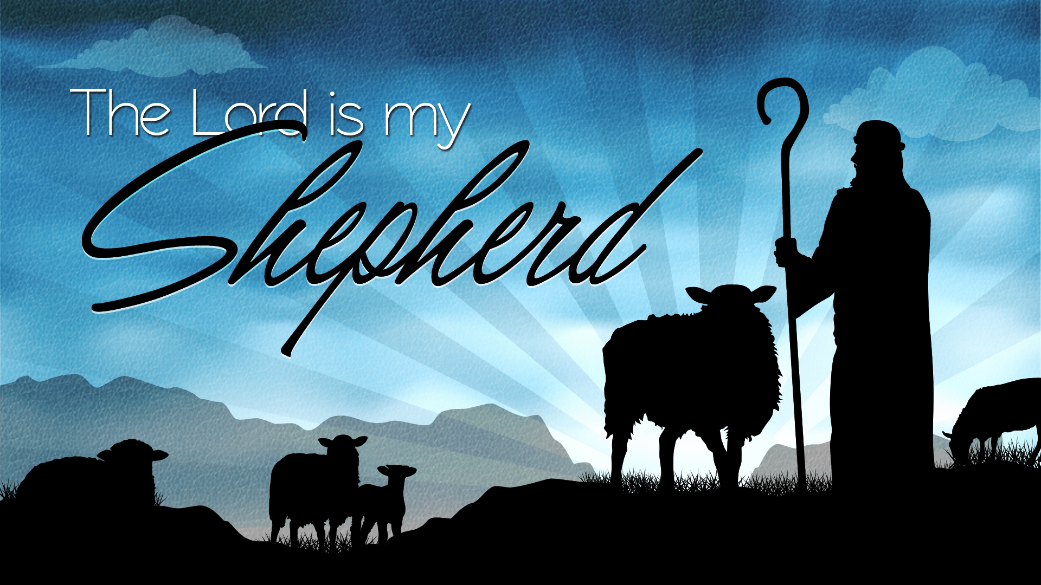

Slide 2
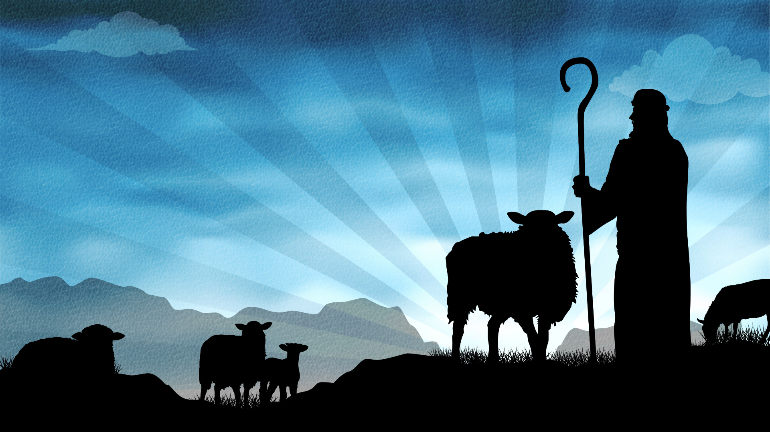
God’s Provision for Mankind - Micah 5:2-5
Sunday, December 29, 2024
Senior Pastor, Dr. Janet Cook

Slide 3

Providence is the foreseeing care and guidance of God.
God is omnisciently directing the universe and the affairs of humankind with wise benevolence.
Providence is the manifestation of divine care or direction.

Slide 4
God’s Provision For Mankind
Micah 5:2, 4-5 Bethlehem Ephratah though you are small among the clans of Judah, out of you will come for me one who will be ruler over Israel, whose origins are from of old, from ancient times. 4 He will stand and shepherd his flock in the strength of the LORD, in the majesty of the name of the LORD his God. And they will live securely, for then his greatness will reach to the ends of the earth. 5 And he will be their peace.

Slide 5
God Provided a Shepherd
      He came to take care of us.
To lead us.
To protect us.
To save us.

Slide 6
1. God Provides Strength
Micah said, (v. 4) He will stand and shepherd in the strength of the Lord.
1 Peter 5:6-7 Therefore humble yourselves under the mighty hand of God, that He may exalt you in due time, 7 casting all your care upon Him, for He cares for you.
He said he is able to do all of these things because he has learned to cast all his cares on Jesus.
1 Corinthians 1:25 Because the foolishness of God is wiser than men, and the weakness of God is stronger than men.
In Bob Weiland’s words, “I do the best I can to apply the Word of God to my life, because I know it works.”

Slide 7
God’s Provision For Mankind
“But see here, you who live in your own light and warm yourselves from your own fires and not from God’s; you will live among sorrows.” (Isaiah 50:11)

Slide 8
You have a shepherd, and you can live in his strength.
“But see here, you who live in your own light and warm yourselves from your own fires and not from God’s; you will live among sorrows.” (Isaiah 50:11)

Slide 9
2. God Provides Security
We can’t depend on the world to offer security, because it doesn’t have it to give. Micah said, (v. 4) And they [his flock] will live securely, for then his greatness will reach to the ends of the earth.

Slide 10
God’s Provision For Mankind
Ezekiel in 34:15-16 - I myself will tend my sheep and have them lie down, declares the Sovereign Lord. I will search for the lost and bring back the strays. I will bind up the injured and strengthen the weak...

Slide 11
God’s Provision For Mankind
God made this promise to us: he said,
“Never will I leave you, never will I forsake you.” (Hebrews 13:5)
“My sheep listen to my voice. I know them, and they follow me. I give them eternal life, and they shall never perish; no one can snatch them out of my hand.” (John 10:27-28)

Slide 12
God’s Provision For Mankind
Jesus offers a kind of security the world cannot offer—it is based on his never-ending love for you.
“There is no place you can go, or nothing that can happen, that extends beyond the power of God to take care of you.”

Slide 13
God’s Provision For Mankind
Jesus came to bring peace to all who follow him. His birth was foretold by Micah with the words, (v. 5) And he will be their peace.
“Glory to God in the highest, and on earth peace to men...”(Luke 2:14)
And as Jesus was approaching death, he said to his disciples,
”Peace I leave with you; my peace I give you....Do not let your hearts be troubled and do not be afraid.” (John 14:27) We can experience His peace in our inner world.

Slide 14
God’s Provision For Mankind
Sheep aren’t industrious; they don’t work for you. They’re good at following. They’re good at trusting. And that’s what God wants you to do: he wants you to follow him...he wants you to trust him.

Slide 15
God’s Provision For Mankind
Remember the words from Ezekiel...
I will search for the lost and bring back the strays. I will bind up the injured and strengthen the weak...(Ezekiel 34:16)
Jesus came into the world to be a shepherd.
Jesus came into the world to seek and save the lost, so that all who follow may experience life in all its fullness.
Christmas is the celebration of God’s provision for Mankind
He Sent His son into the world as our Shepherd

Slide 16
God’s Provision For Mankind
Psalm 23
1 The LORD is my shepherd, I shall not be in want.
2 He makes me lie down in green pastures, he leads me beside quiet waters,
3 he restores my soul. He guides me in paths of righteousness
for his name's sake.

Slide 17
God’s Provision For Mankind
4 Even though I walk through the valley of the shadow of death, ^{[a]}
I will fear no evil, for you are with me;
your rod and your staff, they comfort me.
5 You prepare a table before me in the presence of my enemies.
You anoint my head with oil; my cup overflows.
6 Surely goodness and love will follow me all the days of my life,
and I will dwell in the house of the LORD.

